Slide 1
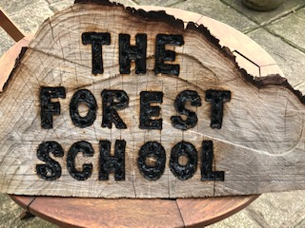

Slide 2


The History of Forest School
The Forest School concept originated in Scandinavia based on ‘frulitsliv’ meaning an ‘open-air culture’, the basis for early years education.
1993 nursery nurses from Bridgewater College visited Denmark looking at the pre-school system.
On return they set up their own Forest School crèche.
1995 Bridgewater College developed Btech qualification in Forest School and offered it to EY practitioners.
Building on UK’s heritage of outdoor learning e.g. Baden Powell and Scouts

Slide 3
The History of Forest School
2000 Wales and Local Authorities in England took up Forest School as a concept within education.
2002 network of practitioners first national conference in the UK and a definition of Forest School was created.
'An inspirational process that offers children, young people and adults regular opportunities to achieve, develop confidence and self esteem through hands-on learning experiences in a local woodland environment.‘
2011 links with the Forestry Commission through Forest Education Initiative (FSI)
2012 the Forest School Association was formed as the new professional association for Forest School and governing body for training.

Slide 4
What is Forest School?
Forest School is an inspirational process, that offers ALL learners regular opportunities to achieve and develop confidence and self-esteem through hands-on learning experiences in a woodland or natural environment with trees.

Slide 5
What is Forest School?
At Forest School ALL participants are viewed as:
equal, unique and valuable
competent to explore & discover
entitled to experience appropriate risk and challenge
entitled to choose, and lead their own learning and development
entitled to experience regular success
entitled to develop positive relationships with themselves and other people
entitled to develop a strong, positive relationship with their natural world

Slide 6
Forest School Principles
FS is a long-term process of regular sessions, rather than a one-off visit; the cycle of planning, observation, adaptation and review links each session.
FS takes place in a woodland or natural environment to support the development of a relationship between the learner and the natural world.
FS uses a range of learner-centred processes.

Slide 7
Forest School Principles
FS aims to promote the holistic development of all those involved, fostering resilient, confident, independent and creative learners.
FS offers learners the opportunity to take supported risks appropriate to the environment and to themselves.
FS is run by qualified Forest School practitioners who continuously maintain and develop their professional practice.

Slide 8
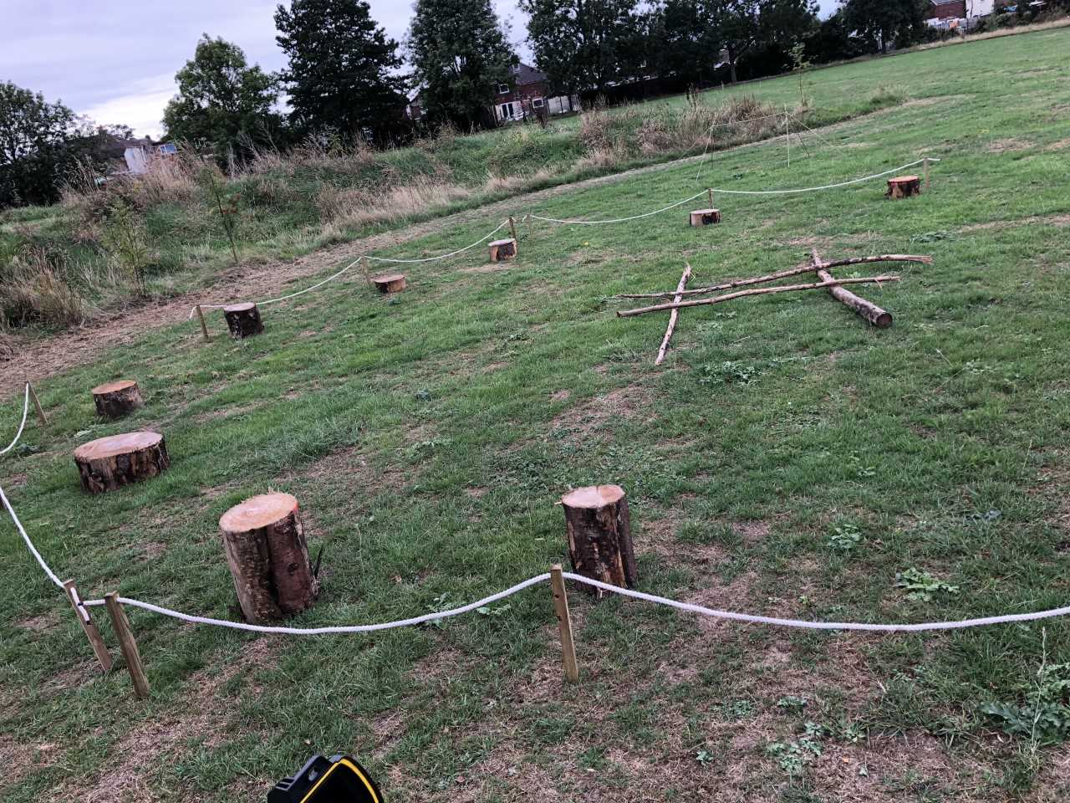
Forest School at St. Michael’s
AIM – To complete individual or small group tasks that help each other achieve set problems. To spark the imagination to re-engage pupils in nature and ideals of forest school whist developing a growth mindset that can be applied in all aspects of learning.

Slide 9
Forest School at St. Michael’s
HEALTH & WELLBEING IN NATURE
COMMUNICATION
POSITIVE BEHAVIOUR
CORE SKILLS FOCUS
CURIOSITY
TEAM WORK
CREATIVITY
DISCIPLINE
TRUST

Slide 10
SESSION | SESSION ACTIVITY – LEARNING OBJECTIVE
1 | First aid. Introduction to tool safety. Forest school conduct and expectations. Forest school pupil voice.
2 | Introduction and explanation of forest school equipment. Individual roles. Importance of forest habitat e.g. examples of trees.
3 | Bug and insect hunt – purpose of bugs and insects to the ecosystem. Develop bug hotel

Slide 11
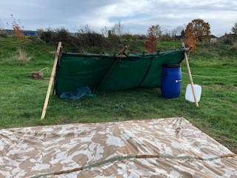
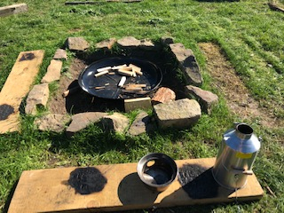

Slide 12
SESSION | SESSION ACTIVITY – LEARNING OBJECTIVE
4 | Camp fire safety. Cooking on a camp fire. Boiling water on a camp fire.
5 | Paired shelter building. Purpose of a shelter in different environments. Team shelter building.
6 | Forest school art and design task. Celebration and rewards. Pupil voice

Slide 13
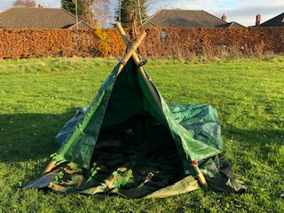
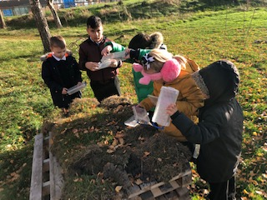
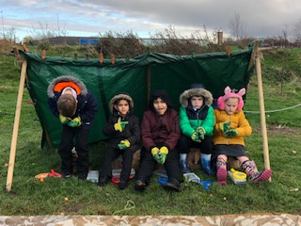

Slide 14
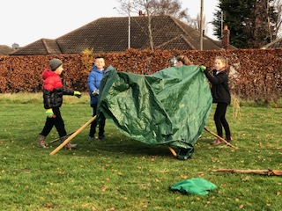
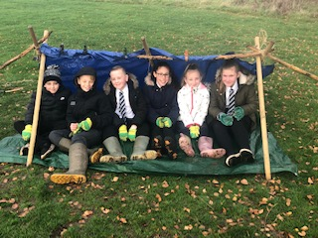

Slide 15
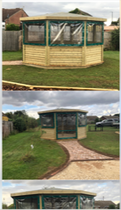
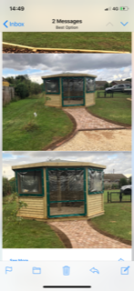
Forest School – Lottery Grant
Recently successful with a National Lottery grant for £9300 to hopefully buy or build a wooden shelter as an outdoor classroom.
Buy 10ft trees
Create an orchard
Buy a shed
Picket fencing

Slide 16
Forest School - can you help?
We are looking for further donations to grow the Forest School, can you help? Do you have any links to companies that could donate equipment?
CHILDREN’S GLOVES
FENCING
WATER BUTTS
PLANTERS
WATERPROOF KIT
WHEELBARROWS
POTS
WELLIES
POLY TUNNEL

